Slide 1
Machine Learning for Task Classification
Pratt and Whitney
Aishwarya Sudhakar
Ariel Reches
Chris Watson
Kruti Chauhan

Slide 2
Motivation: Save Time, Cost and Effort
Problem
Assign tickets to a analyst or group of analysts
Descriptive Textual Data
Categorical Data
New Tickets
Extraction & Preprocessing
Vector space
representation
Buckets
Notes:
We are understanding to assign the tickets in two ways:
Buckets of topics
Person

Slide 3
Dataset
Pratt and Whitney Dataset | Mozilla Dataset | Data Type
Task ID | Bug ID | Unique Id
Task Description | Bug Description | Free Text
Task Type | Product | Categorical
------------------------------ | Component | Categorical
Task Short Description | Keywords | Free Text (Short)
Task Status | Bug Status | Categorical
Analyst ID | Assignee | UniqueId
Notes:
Introduce our dataset. Highlight the different data types we have - and the categorical column missing in PW s dataset

Slide 4
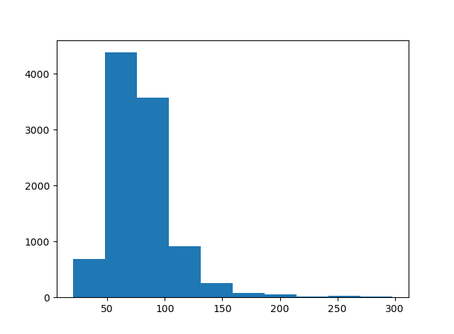
Dataset
Bug Id | Bug Desc | Product | Component | Keywords | Bug Status | Assignee
726 | Calendar services try to add and remove profile-after-change observers | Calendar | General | Assertion | new | yogeshgupta
ISSUES
Short Text Description - Sparse Matrix
Poorly formatted Text Description
TOTAL: 9937 Bugs
Histogram of Input Length
Notes:
The example is from mozilla dataset. Highlight the distribution of character length in Bug Desc column. Poorly formatted text description is that we cannot understand much about the bug from the description like the example “Calendar services try to add and remove profile-after-change observers”. We have a total of 9937 bugs.

Slide 5
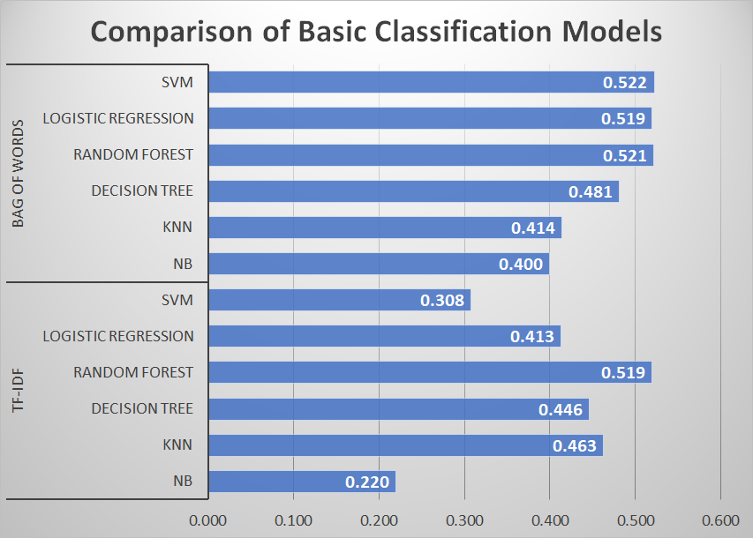
Baseline Models and Results
Vectorizers
Bag Of Words
TF-IDF
Classifiers
K-NN
SVM
Decision Tree
Logistic Regression
Naive Bayes
Notes:
These are the initial results we tried.

Slide 6
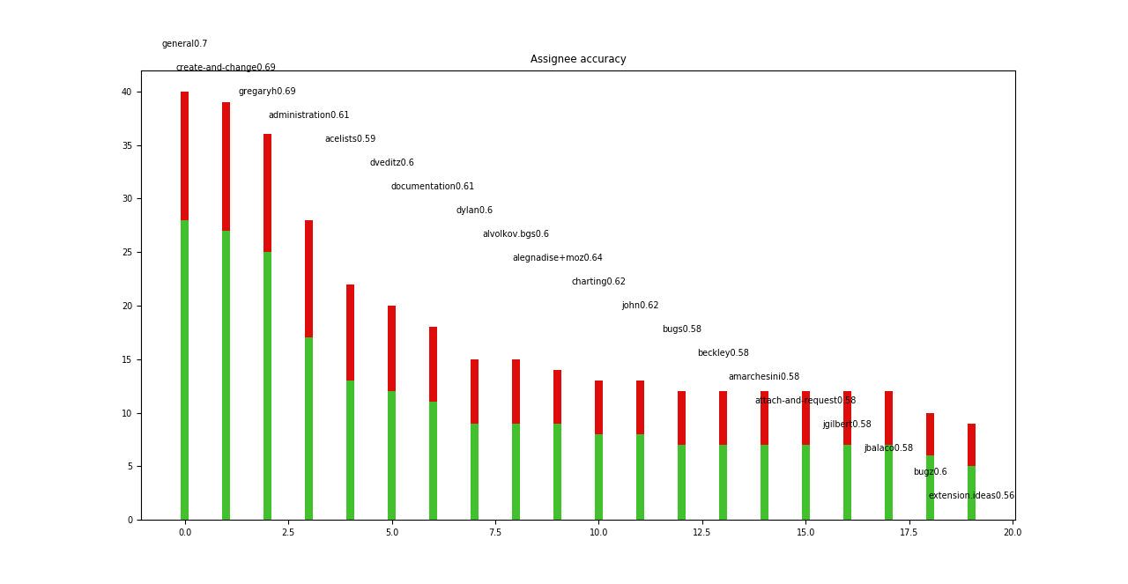
Examples
Notes:
\

Slide 7
2. Interpreting Word Vectors
Goal: Understand the similarity between word-vectors in the text input
Text + Categorical - (Description + Component)
SVD ~ 70% variance
17417 x 9937
17417 x 1000
Query: security
Actual: javascriptvalidatelogin (1 bug), presenting (1 bug), awarded (1 bug)
Expected: process, sandboxing, enterprise, information
Reason: Enterprise Process Sandboxing (35 bugs), Enterprise: Information Security(20 bugs)
Notes:
We used dimensionality reduction to interpret the representation of words in our dataset based on the common vectorizers (tfidf / bow). We took the input matrix - reduced its dimensionality using SVD, we then searched the subspace for similar words, where we used cosine similarity for distance. When using the free text column, the output was less valuable. We found that the closest words were unrelated to the query word.

Slide 8
Interpreting Word Vectors
Goal: Understand the similarity between word-vectors in the text input
Categorical + Categorical + Free Text (short) - (Product + Component + Keywords)
SVD ~ 70% variance
892 x 9937
892 x 50
Query: security
Actual: process, sandboxing, enterprise, information, caps, risk
Expected: process, sandboxing, enterprise, information
Reason: Enterprise Process Sandboxing (35 bugs), Enterprise: Information Security(20 bugs)
Notes:
As an experiment we removed the free text representation and used only the categorical column. This reduced the size of the corpus to a large extent and also the results of the query were much more sensible as the closest words were ones with more co-occurrences than the other.

Slide 9
3. fastText - Facebook AI Research Lab
Why we need it?
A hierarchical classifier
Places frequently occuring classes at smaller depths
Alternative to Word2Vec with a text-classification feature
Getcontentdimensions | Browserelementchildpreload
Sub-word embeddings / character n-grams
Wanted the fast of fastText
Notes:
After analyzing the word vectors we learnt that most of the words were joined together. We needed a character n-gram model for representing our data. We use fastText a hierarchical classifier because the distribution of classes in the dataset is not balanced.

Slide 10
fastText - Results
52% - 59% Precision
47% - 49% Precision
Categorical + Categorical + Free Text Product + Component + Keywords
9937 = (Tr:6397 | V: 3000)
Categorical + Categorical + Free Text + Free Text Product + Component + Keywords + Summary
9937 = (Tr:6397 | V: 3000)
Notes:
These were the results from the fasttext used as a classification model. This shows that the metadata performs better than the free text.

Slide 11
4. Unsupervised Learning
Pipeline
FASTTEXT
TEXT REPRESENTATION
BUILD INPUT MATRIX
CLUSTERING
Skip Gram
Bag Of Words
Convert Text Representation from fast text into input matrix
KMeans
Agglomerative Clustering
Notes:
P&W wanted to know if this problem is solved by unsupervised modeling. We used basic vectorizers for clustering but did not get good results.
So we used the fasttext text representation to built the input dataset and performed clustering. We used each analyst as their own cluster as we didnt have ground truth for multiple analysts in a cluster. FastText has two text representations - Skipgram and Continuous Bag of Words and we tried both. For Clustering we tried simple KMeans and Agglomerative Clustering using average linkage from sklearn.

Slide 12
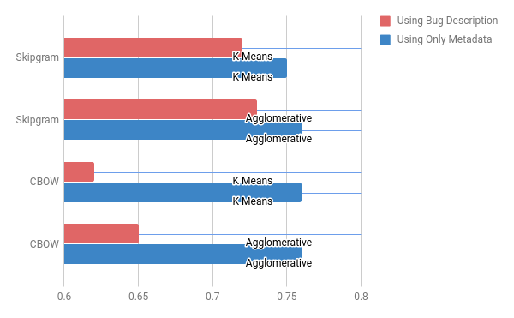
Clustering Results - Homogeneity
Notes:
We used the classification labels as ground truth to measure the homogeneity of clusters. We got pretty good clusters compared to used the basic vectorizers. Notably, using metadata alone which is the categorical columns, the bag of words and the skip-gram representation gave almost similar results. However, Using the bug description where words were joined together, the bag of words did not do that well. Whereas the character n-gram gave better separated clusters.

Slide 13
Interpreting Clusters
Although clusters were homogenous we can not use them as classification results
E.g:
Bugs: firefox, wifi
True Assignee: changysin (24 bugs)
Pred Assignee: 10 different clusters
Pred Cluster for Changysin (13 bugs)
Bugs: firefox, core, thunderbird, tasks
Unable to identify which assignee maps to which cluster
Clustering
Notes:
We got good clusters, but how do we convert them to a deliverable? How do we map assignees to clusters. When true and predicted clusters are varied? A cluster in a prediction has bugs from different components attached to it.

Slide 14
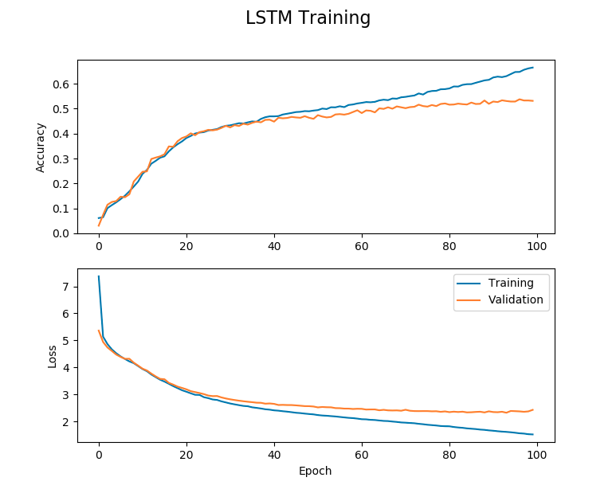
5. Deep Learning
Bi-Directional LSTM
Accuracy:
Top 1 52%
Top 2 61%
Next Steps:
Handoff to P&W
Trying different preprocessing (fast text)
Different network architecture (CNN)

Slide 15
What Worked
What Didn’t
Supervised Learning approaches
Deep Learning
Clustering using basic vectorizers
Clusters as a feature for classifiers - No Improvement
Using dimensionality reduction for classification - poor results
Topic Modeling using LDA - Poor results

Slide 16

P&W obtained an accuracy of 80% on their dataset as opposed to 60% on the Mozilla dataset using baseline models

Slide 17
Next Steps
Questions?
Thoughts...
Updated deliverable for P&W
Continue to optimize deep learning models

